Slide 1
ATHLETICS OFFICIATING
SUMERA SATTAR
LECTURER PHYSICAL EDUCATION LCWU

Slide 2
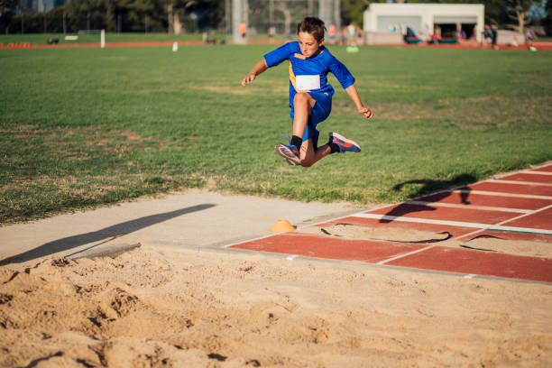
History
The long jump was an event included in the Ancient Greek Olympics, although it had significantly different rules back then. The long jump for men has been a modern Olympic event since 1896, along with the standing long jump. However, the latter event was dropped after the 1912 Olympics. A women's Olympic long jump event was added in 1948. The event is sometimes called "the broad jump."

Slide 3
Equipment and Long Jump Rules The sole of a long jumper's shoe can have a maximum thickness of 13 millimeters. Spikes are allowed. The runway must be at least 40 meters long. Competitors may place as many as two location markers on the runway. The jumper's farthest point forward in contact with the take-off board, i. e., the toe of the jumper's shoe, must be behind the leading edge of the take-off board. The board itself must be 20 centimeters wide and level with the ground. Somersaults are not permitted. Jumpers must land within the sand pit in the landing area, which may vary in width from 2.75 to 3.0 meters.

Slide 4
How Do They Measure the Long Jump?
Long jumps are measured from the forward edge of the take-off board to the impression in the landing pit closest to the take-off board made by any part of the body of the jumper.
Each jump must be completed within one minute from the time the jumper steps onto the runway. Jumps executed with a tailwind or more than two meters per second don't count.

Slide 5
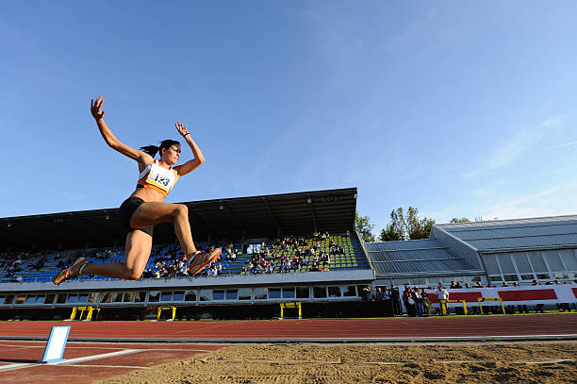
THE COMPETITION

Slide 6
Twelve competitors qualify for the Olympic long jump final. Results from the qualification rounds do not carry over into the final.
Each finalist takes three jumps, and then the top eight jumpers receive three more attempts. The longest single jump during the final wins. If two jumpers are tied, the jumper with the longer second best jump is awarded the medal.

Slide 7
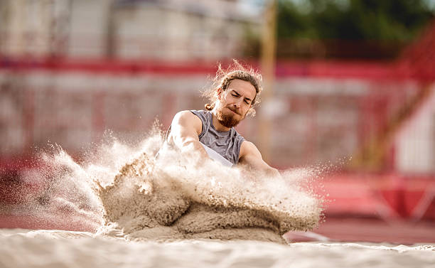
The complexity of the Long Jump

Slide 8
Viewed casually, the runner stands at the beginning of the runway, accelerates to the take-off board, then jumps as far as he or she can.
In reality, the long jump is one of the more technical Olympic events. There are at least three different techniques for approaching the take-off board, each with its arm and body position. The maximum acceleration is achieved with the longest legal run-up (by using the full 40 meters of the runway). But the more steps the jumper takes, the more difficult it becomes to calibrate the take-off with the forward edge of the runner's take-off foot as close as possible to the leading edge of the take-off board without fouling.

Slide 9
All but the last two strides are normally the same length. The second-to-last stride, however, is longer and is designed to lower the runner's center of gravity. The last stride is shorter than the others and is designed to do the opposite, to lift the center of gravity of the jumper's body as high as possible to begin executing the jump itself.

Slide 10
Long Jump Pit Sizing
The clients also have control over the long jump pit sizing, this allows for institutions such as primary schools and high schools to save money over the size of the pit, also as it’s unlikely that primary school children would be able to jump as far as professional athletes, the long jump pit sizing being small won’t affect the facility for them. The standard IAAF size for a long jump pit is 9 meters by 2.75 metres; therefore long jump pit sizing must be to these dimensions if the facility is being used competitively. With the change in long jump pit sizing, the size of the sand pit cover will also have to be altered to ensure it fits the landing pit properly and provides adequate protection

Slide 11
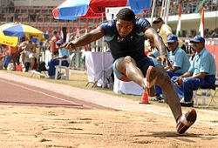
Men's records
World
Mike Powell 8.95 m (29 ft 4 1⁄4 in) (1991)
Olympic
Bob Beamon 8.90 m (29 ft 2 1⁄4 in) (1968)
Women's records
World
Galina Chistyakova 7.52 m (24 ft 8 in) (1988)
Olympic
Jackie Joyner-Kersee 7.40 m (24 ft 3 1⁄4 in) (1988)
Long jumper at the 2007 Military World Games

Slide 12
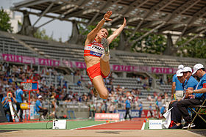
TECHNIQUES
There are five main components of the long jump: the approach run, the last two strides, takeoff, action in the air, and landing. Speed in the run-up, or approach, and a high leap off the board are the fundamentals of success.
Emmanuelle Chazal competes in the women's heptathlon long jump final during the French Athletics Championships 2013 at Stade Charléty in Paris, 13 July 2013.

Slide 13
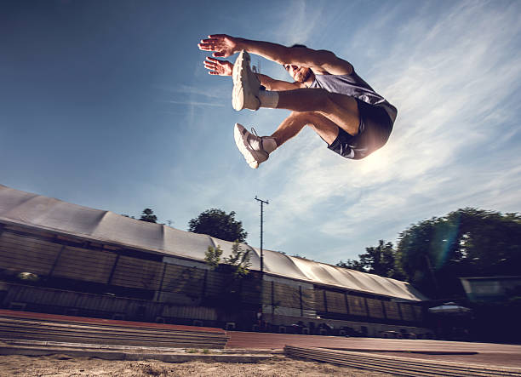
TIE

Slide 14
TIE If there is a tie for the final place(s) for the next round of a long-jump competition, all competitors who are tied with each other progress to the next round regardless. In the case of any tie at the end of the entire competition, competitors' second-best jumps will be decisive. If there is still a tie, then it is the third-best jump that counts, and so on.

Slide 15
LONG JUMP OFFICIALS
• Ideally the minimum number of officials required to run the long Jump is four (4)
(1) CHIEF JUDGE(Official)
• Allocate Officials to the various positions.
• Supervise the preparation of the area regarding safety, equipment.
• Ensure that the facility complies with the rules of competition.
• Prior to the commencement of competition, provide an outline of the rules of the
event to the competitors, define the competition area advancer criteria.
• Define the take off board and advise the athletes.
• Rule on the validity of the attempt and indicate a fair jump with a white flag and a foul.

Slide 16
• Advise the athlete the reason for the foul - Announce/call out the distance measurement where the tape aligns with the edge of the board nearest the pit. (2) OFFICIAL TWO (Recorder) • Call up the competitors and record the results. • Jumps are measured perpendicularly in a straight line from the edge of the takeoff board or its’ extension nearest the landing pit, to the mark made by the competitor in the landing pit nearest the takeoff board. • Record the result to the nearest centimetre below the distance achieved. • i.e. 11 m755 becomes 11m75.

Slide 17
LON • Repeat, call out, the measurement called by the Chief Judge to ensure the measurement recorded is correct and that the athlete hears it • All attempts must be recorded ( F, P, or Measurement) • Time the trial and indicate with a yellow flag when the last fifteen (15) seconds of the allowed one (1) minute or longer, in accordance with the rules of competition, remain for that trial (3+4) OFFICIALS THREE AND FOUR • Stand well away from the sand pit trials to avoid distracting the competitors • Rake the sand back to level with board as required - To be legal, the jump must end in the pit. - When it is determined to be a “fair” jump : • place a short marking stake at the point in the sand where the the athlete has broken the sand with any part of the body, usually the foot, nearest to the takeoff board • hold the zero end of the measuring tape to the stake/marker.
• Repeat, call out, the measurement called by the Chief Judge to ensure the measurement recorded is correct and that the athlete hears it. • All attempts must be recorded ( F, P, or Measurement). • Time the trial and indicate with a yellow flag when the last fifteen (15) seconds of the allowed one (1) minute or longer, in accordance with the rules of competition, remain for that trial.

Slide 18
(3+4) OFFICIALS THREE AND FOUR • Stand well away from the sand pit trials to avoid distracting the competitors • Rake the sand back to level with board as required - To be legal, the jump must end in the pit. - When it is determined to be a “fair” jump : • place a short marking stake at the point in the sand where the the athlete has broken the sand with any part of the body, usually the foot,
nearest to the takeoff board • hold the zero end of the measuring tape to the stake/marker.

Slide 19
Long Jump Officials' Duties
Check in at Meet Site Get meet information Long Jump Officials' Package - Get clipboard (if provided) - Get measuring tape - Get Score sheet(s) for LJ competition and ribbons (in the event package) - Find out who is the Field Referee, and where thew sports medical trainer is located.

Slide 20
Equipment List Two rakes. Rule and Case Book. Pens/Pencils. White Athletic Tape / Coloured Tape. Tape Measure. Stop watch ( 1 minute timer) Plastic bag (for clip board in case of inclement weather). - Folding chair , umbrella. Apparel Appropriate for the weather--- raingear, hat, sunblock. Inspect.

Slide 21
Inspect Area Check all equipment - run way - sand pit - appropriate score sheets Check surrounding area for obstacles and remove any. Ensure that the sand is level in the landing area and the runway is clear. Check in the competitors - Check for any athlete who may be at a track event at check in and any who may have to interrupt their attempts to go to a track event – DNS beside name of any competitors who do not check in.

Slide 22
Introduce fellow officials Before Competition begins, call athletes together and review rules (see last page). Proper Uniform. Track events precedence -allow rest time after the completion of the track event. Clarify the event rules--- Number of jumps (Preliminary / Zone Meet). - Tape may be used on the white lines bordering the runway, not on the runway. 60 seconds after called to attempt.

Slide 23
Successful Coaching Requires...
• Balance between mechanics and natural movement.
• Build a relationship/trust relationship/trust. • K.I.S.S. principle – Keep it simple, stupid! • K.I.L.L also good– Keep it likeable, learnable. • Pragmatic approach.
• Being an archeologist
–– Brush away the the clutter toto reveal the treasure.

Slide 24
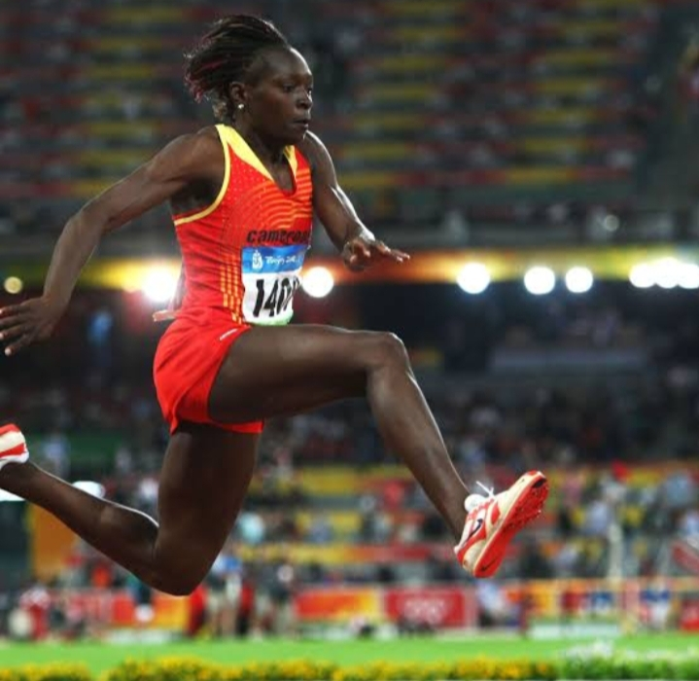
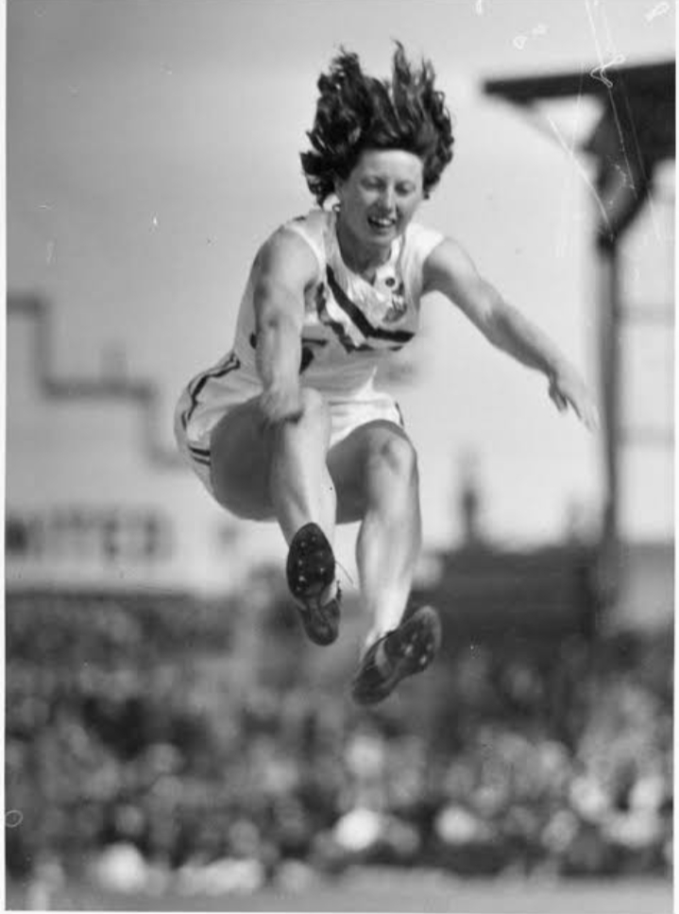
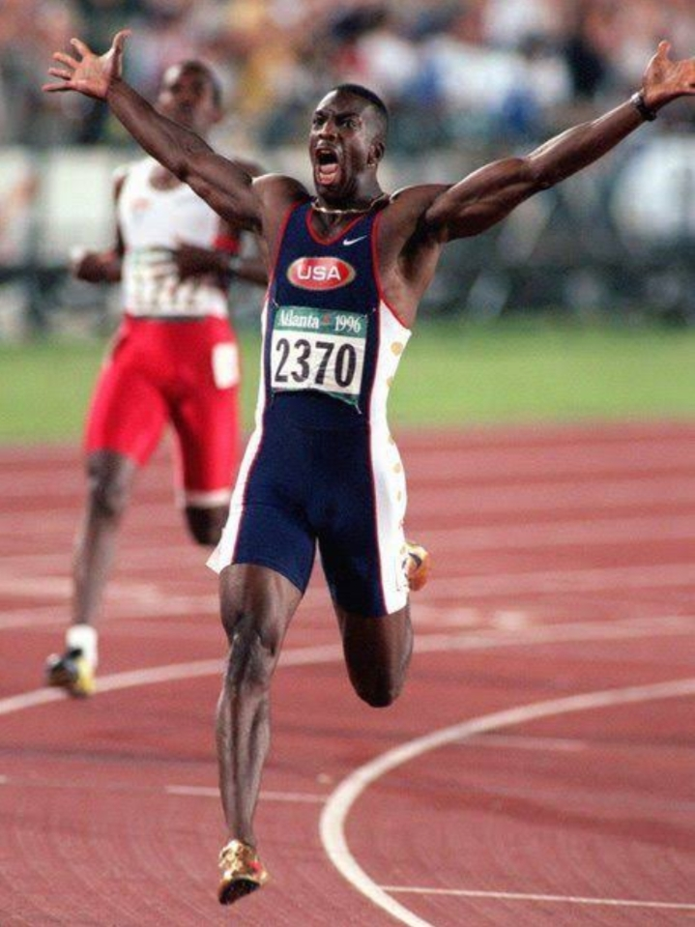
Treasurers

Slide 25
Training Overview
• Progression, communication, aggressive patience, adapt before adding, and personal care. • Move from low to high stress. – Emphasize speed and rest during championships phase. • Speed training is critical. • Conditioning/strength emphasis in the winter – Moderate interval training with set rest periods

Slide 26
The Warm-Up
• Barefoot strides on infield grass.
• Sprint mobility drills.
• Static stretching.
• Dummy sprint drills/3 box plyo hops.
• Weighted jump‐roping/weighted arm swings. • Hurdle walk‐overs.
• Short break before the day’s workout.

Slide 27
Approach Training
• Work away from the jump area. • Mark steps. • Count method. • Acceleration patterns. • Time the runs. • Work on consistency. • Tape on penultimate/3rd from last for steering.

Slide 28
Jump Workouts...
• Sets of 6‐stride jumps – One, two, three, four, five AND six – First set for height, second set for distance • Incline box jumps for in‐air technique • Small 2”, 4”, 6” black box drills • End with runway work or sprints on the track • We use early meets to practice the full approach and jump—this is critical!

Slide 29
In Competition
• Beauty of three/six three/six attempts attempts – Ideally we want a legal first jump, but we try to have all of them did the “same – Next jumps • less concern over over fouls fouls • “Just go for it” mentality – Come out focused and hit a winningg j p jump early – 1 jump—anywhere in the sequence wins.

Slide 30
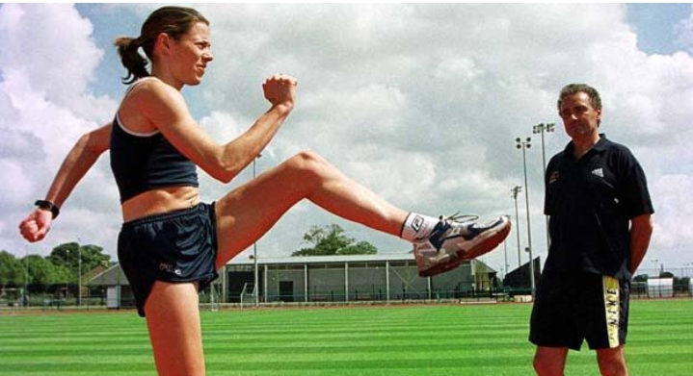
Mental Aspects
• Confident and relaxed—am convinced. cannot “try” to jump. Trust and let it “happen” •• Cut the head off on meet day. • Be YOU‐‐‐Do what YOU do. • Plan at practice, PERFORM at meets.
Trust.

Slide 31
Talent Identification
Schools have trials by doing normal athletic events. There are many talented children hidden in our schools and if children can be scouted and told about their hidden talents, they will also become more interested in sports like athletics, for example. The children who have been coached for a year by a good or bad coach win the school events, but in every school there are children with lots of talent that have not been discovered. Schools have trials by doing the proper 60m/80m/100m to 400m or long jump, discus etc. and again the child who has been coached by a good or bad coach wins. Sometimes the talented child is not selected and gets no chance to run for his/her school and stops training.

Slide 32
Contemporary performance demands are so high in Track and Field that athletes with average ability are not going to succeed, even if the best training methods are employed. This emphasizes the importance of correct selection procedures for a particular event. The height of an athlete is often important for selection. However, coaches, frequently prefer shorter athletes because they are usually better coordinated and produce better short term results than their tall counterparts. It occurs regardless of the fact that the taller athletes may have a much better potential.

Slide 33
Some tips in testing, identification and development:
Talent identification should occur when an athlete is not currently participating in athletics, but is identified as showing potential in an athletic event.
If an athlete is already participating in Track and Field, cross country or on the road and is shown to be talented in that event this is more appropriately referred to as talent development.
Talent identification is most suited to events which have obvious physical and physiological requirements. In events where success is determined by skill and strategy the ability to predict performance is more difficult.

Slide 34
4. The training programme must be coordinated in schools and test results should be sent to provincial bodies.
5. Base level screening tests can be administrated by teachers and analyzed by athletic coaches and the provincial coaching committee.
6. After identification sport-specific tests should be used to refine the selection process.
7. This can only be successful when a well structured and resourceful talent development programme is provided.

Slide 35
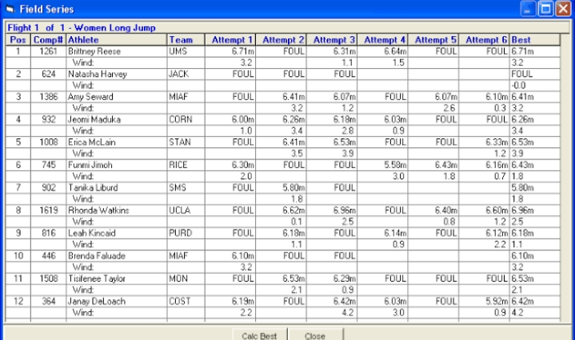
Score Sheet for Long Jump

Slide 36
Thank you for your attention!
Questions?
Comments?
Jokes?

